Slide 1
Bus. Communication Class 3 Dr. Clara Ma Have you ever listened to a presenter who sounded super smart – without having any ideas what she really said?

Slide 2


Slide 3
1. Warmup: discussion on learning 2. Elevator pitch 3. Informational Interview Project 4. Group Presentation 5. Cultural gap 6. Visual representation of your learning process, marking key moments of insight or challenge.

Slide 4
Let us keep the conversation going: Elevator Speech
What was the most challenging aspect of creating your elevator pitch? How did you overcome it?
What strategies did you use to make your elevator speech memorable and engaging to the listener?
How did peer feedback influence your final pitch?
Were there any surprises or unexpected reactions when you presented your elevator speech to others?
Looking back, what would you do differently? What did you learn from this exercise that you can apply in future professional situations?
Notes:
Slido or kahoot takeaways

Slide 5
Informational Interview Request
Start with a polite introduction after searching on linkedin.
Briefly introduce yourself.
Highlight shared connections or interests.
Clearly state the email's purpose.
Include a timeline or deadline if relevant.
Conclude with gratitude and a call to action.
Submit your email to the discussion board.

Slide 6

Your reader or audience always wonders…
What’s In It For Them?
(WIIIFT)

Slide 7
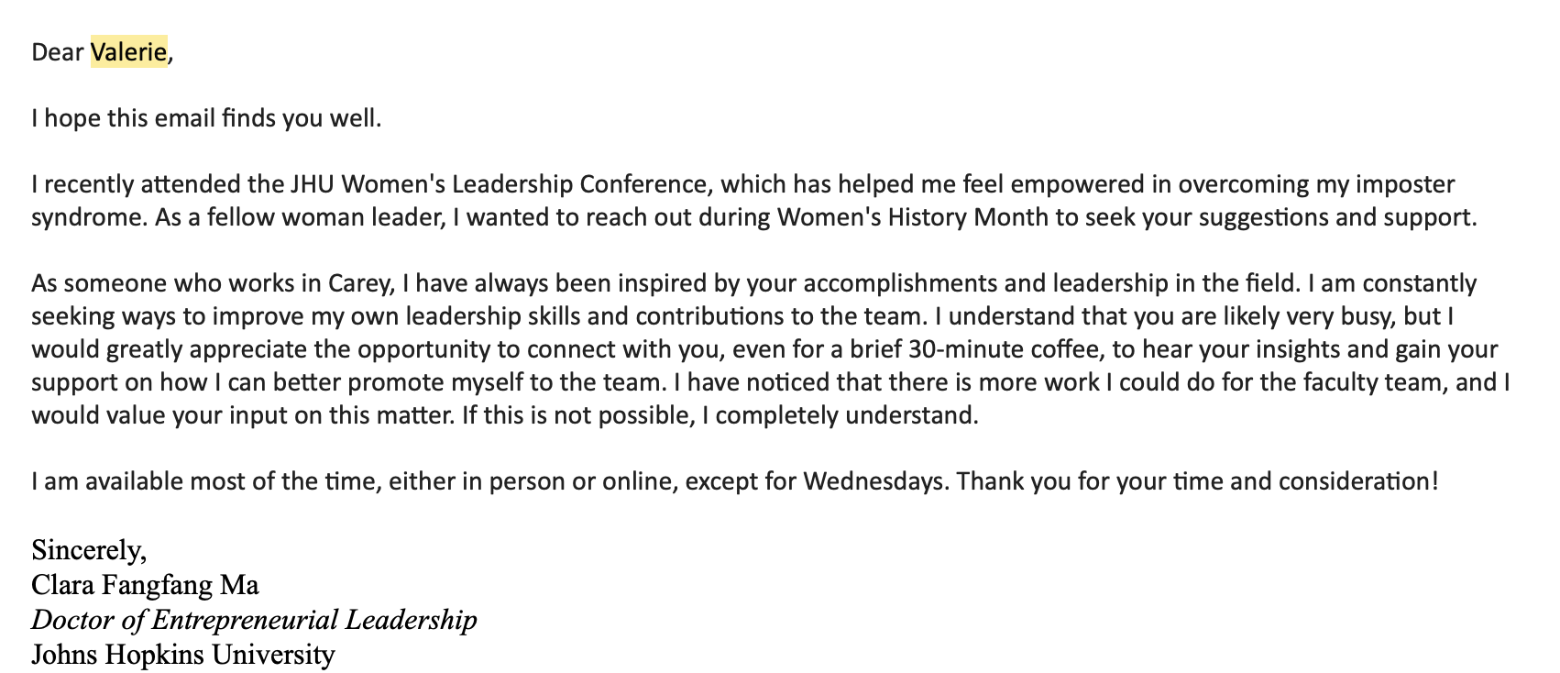

WIIIFT

Slide 8
And don’t forget the all-important factor: High Skim Value Show me where it is in your textbook!

Slide 9
HSV
Dear Professor Ma,
Good morning! I am Jing Wang (Jenny) from Business Communication X6.
Today is Teacher's Day in China, and I want to take this opportunity to wish you a happy Teacher's Day. I am deeply grateful for your guidance and encouragement in our Business Communication class. You have helped us learn how to maintain healthy conversations without awkwardness, and thanks to your teachings, I am gradually improving my communication skills.
Thank you again for bringing such infectious positive energy to our class. I look forward to learning more in the upcoming lessons.
Best regards, Jing

Slide 10
Let us talk about your upcoming group persuasive presentation!
Why was this advertisement persuasive/influential?
Simplified, gets to the core of the idea
Surprising, unexpected
Concrete instead of abstract
Credible, believable, trustworthy source
Elicits emotional reactions
Tells a story

Slide 11
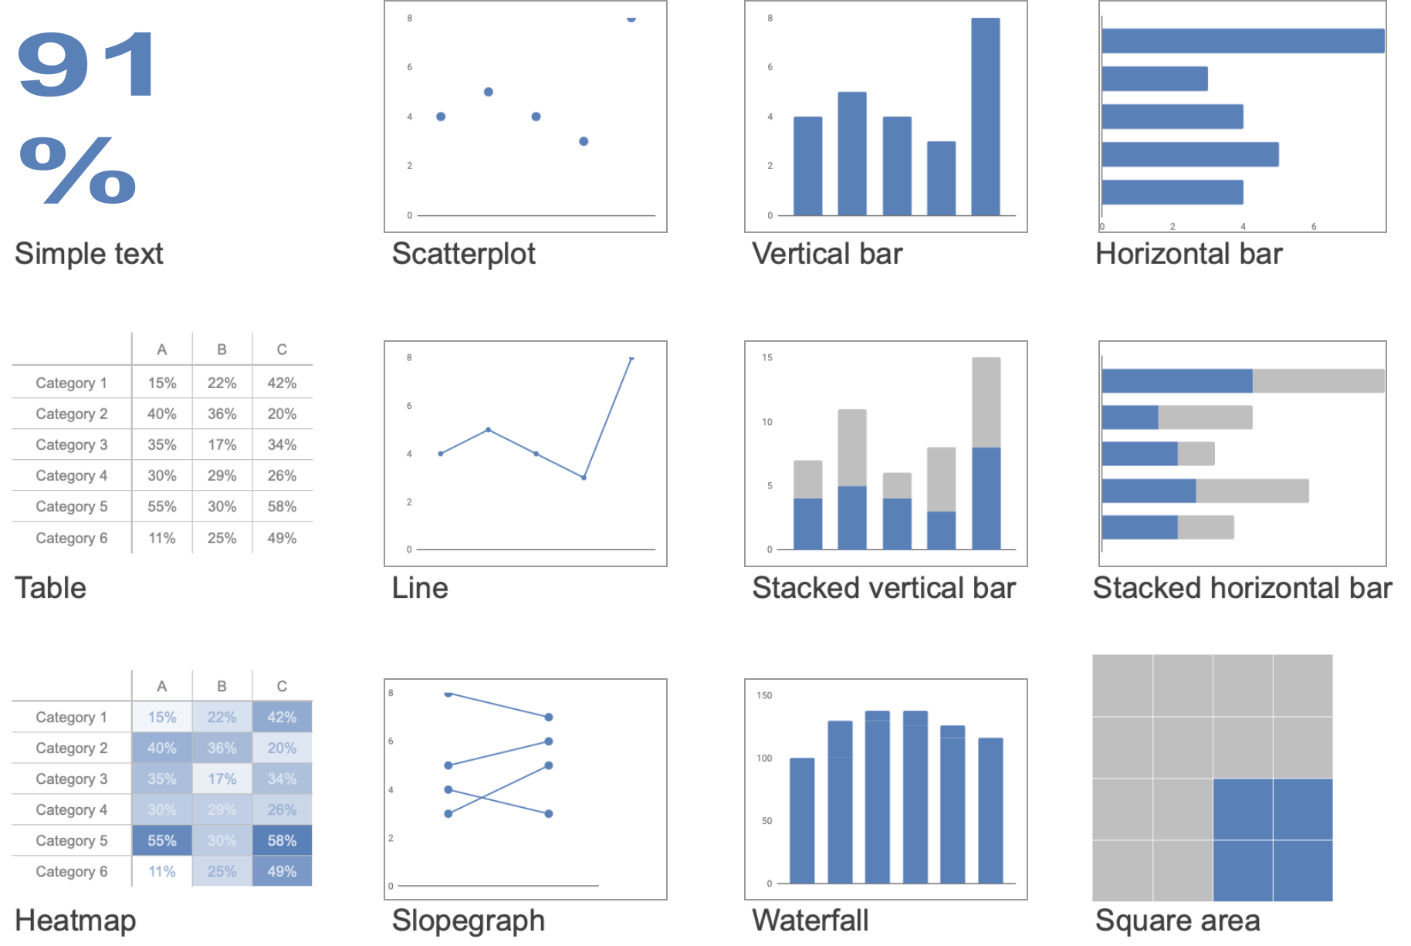
Best types of data visualizations

Slide 12
Knaflic, Cole. storytellingwithdata.com. © 2022

Slide 13
Strategic words and color bring data to life
Knaflic, Cole. storytellingwithdata.com. © 2022

Slide 14
Knaflic, Cole. storytellingwithdata.com. © 2022

Slide 15
Choose graphs that are easy to read
Knaflic, Cole. storytellingwithdata.com. © 2022

Slide 16
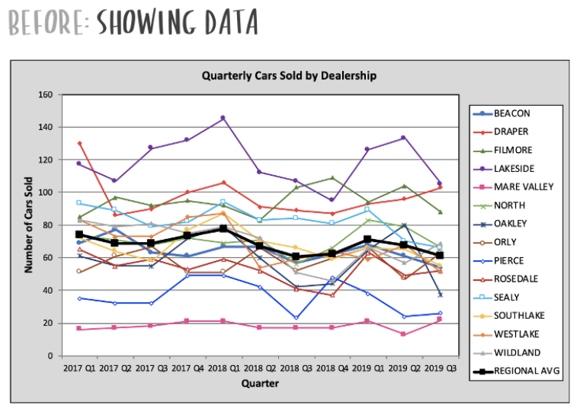
Knaflic, Cole. storytellingwithdata.com. © 2022

Slide 17
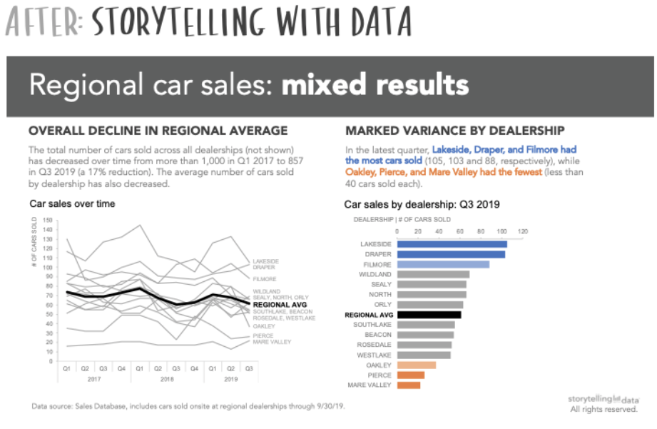
Eliminate clutter to make data sing
Knaflic, Cole. storytellingwithdata.com. © 2022

Slide 18
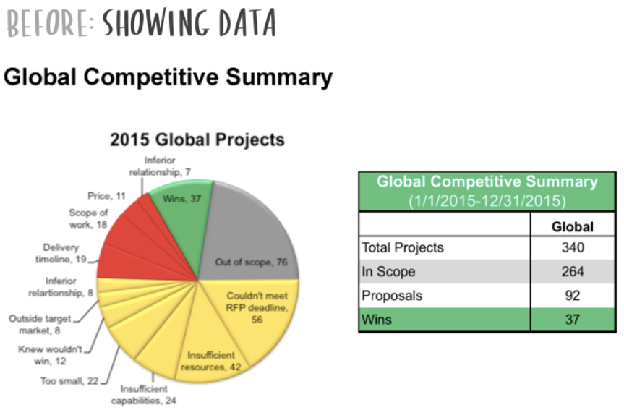
Knaflic, Cole. storytellingwithdata.com. © 2022

Slide 19
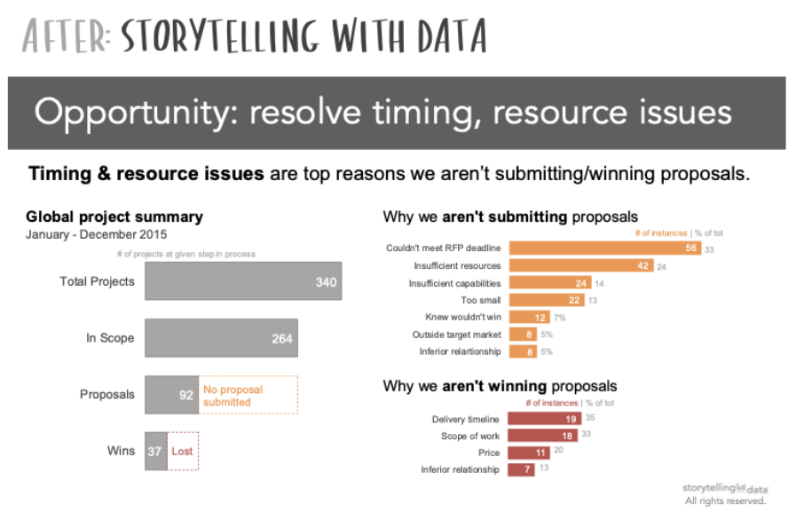
Connect the dots for your reader / audience
Knaflic, Cole. storytellingwithdata.com. © 2022

Slide 20
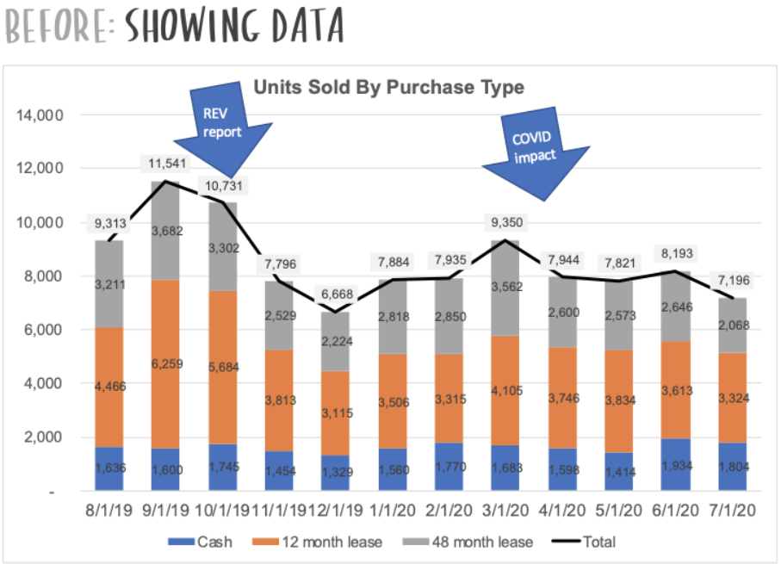
Knaflic, Cole. storytellingwithdata.com. © 2022

Slide 21
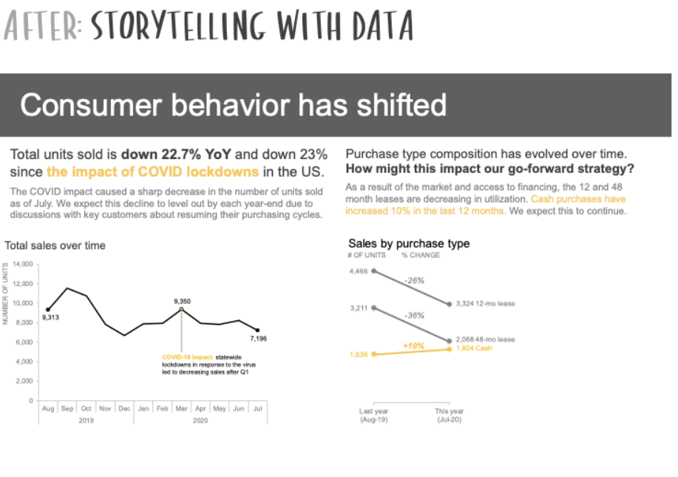
What’s your end-goal? Design for that
Knaflic, Cole. storytellingwithdata.com. © 2022

Slide 22
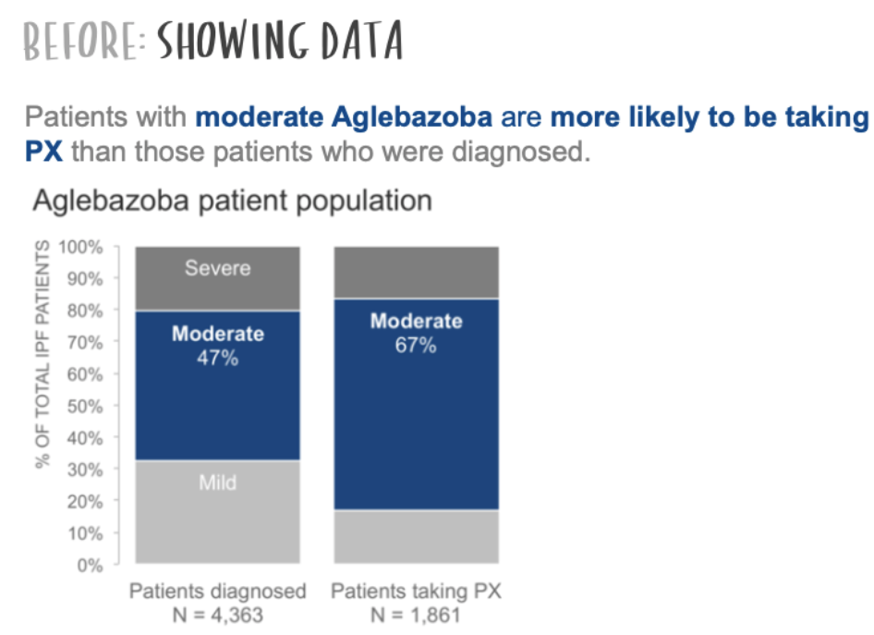
Knaflic, Cole. storytellingwithdata.com. © 2022

Slide 23

Call to action > Insights
Knaflic, Cole. storytellingwithdata.com. © 2022

Slide 24
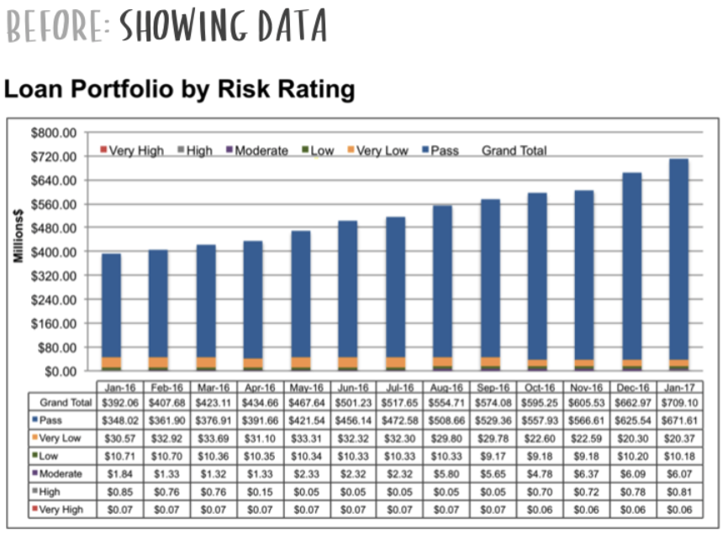
Knaflic, Cole. storytellingwithdata.com. © 2022

Slide 25
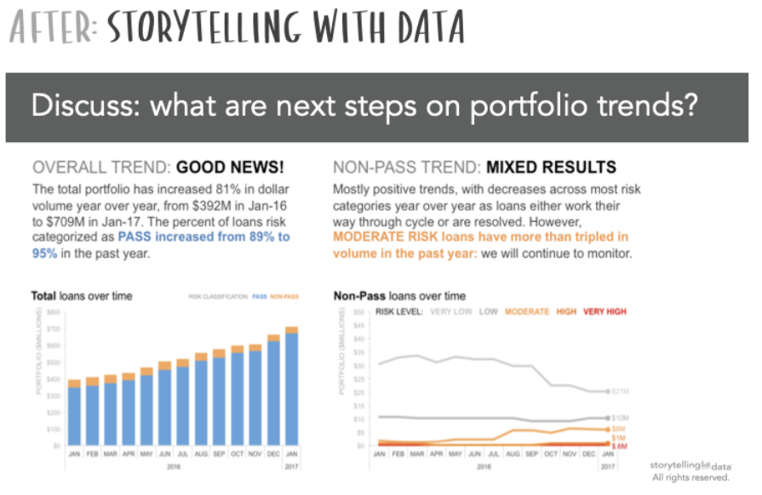
Please don’t pack it in
Knaflic, Cole. storytellingwithdata.com. © 2022

Slide 26
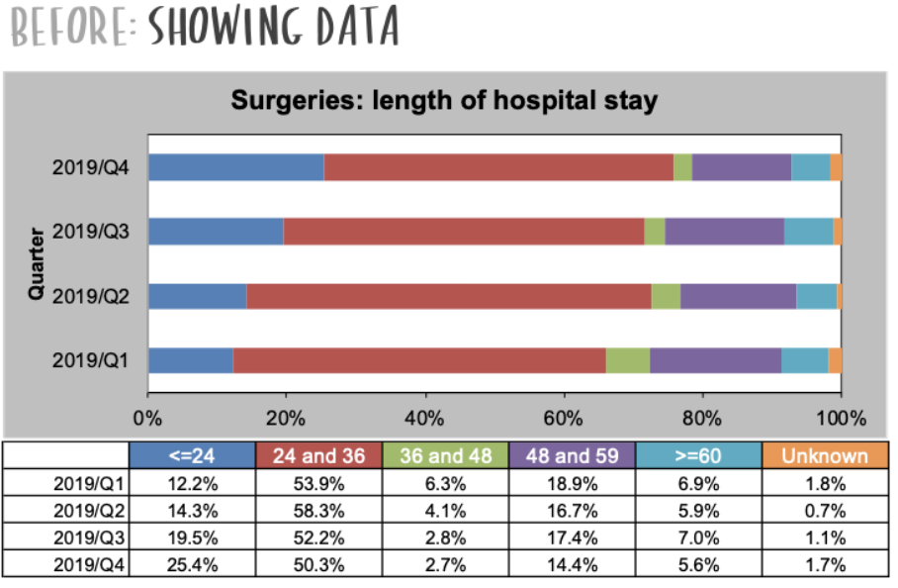
Knaflic, Cole. storytellingwithdata.com. © 2022

Slide 27
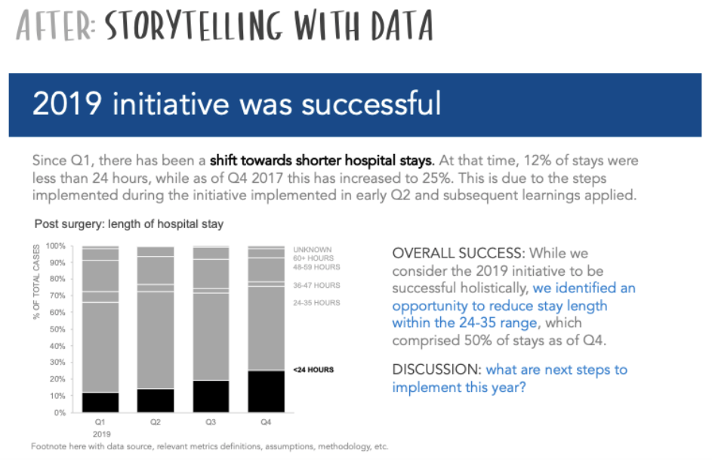
Data viz tools don’t tell stories — YOU do
Knaflic, Cole. storytellingwithdata.com. © 2022

Slide 28
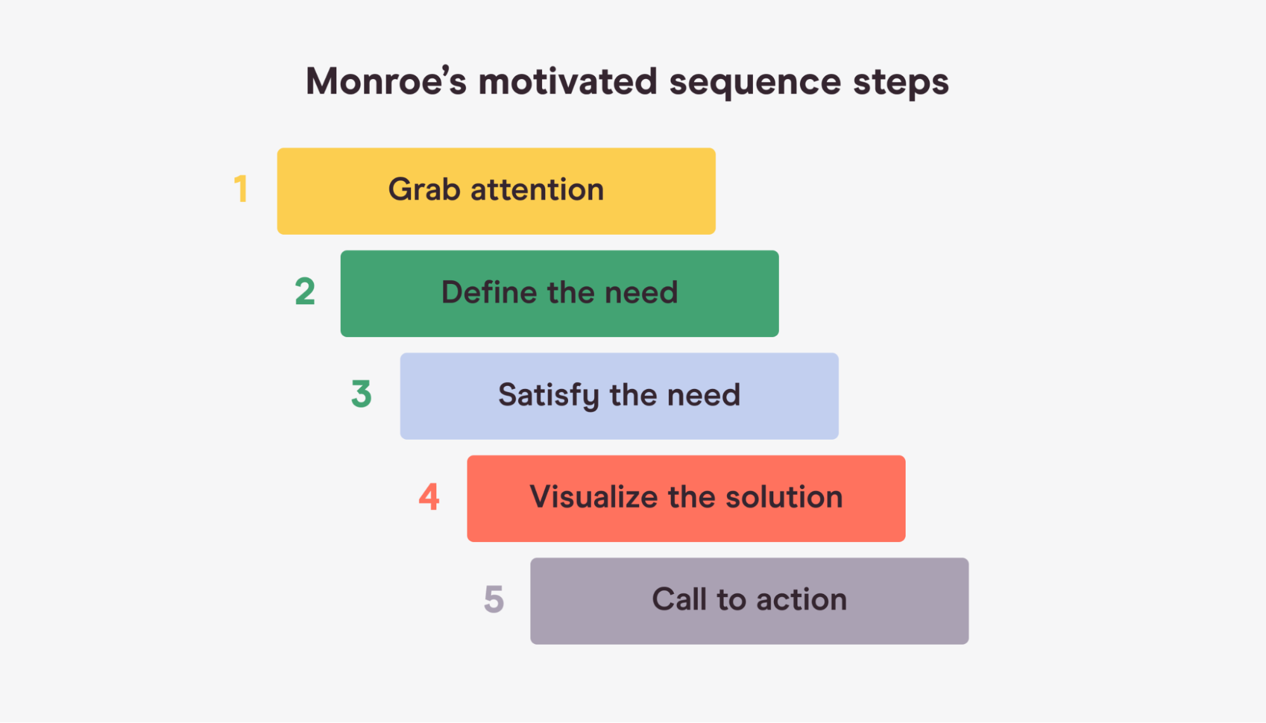
Monroe’s Motivated Sequence

Slide 29
Attention
[Hold up a Reese’s Peanut Butter Cup]
How many of you feel that midday slump during our long school hours?
That moment when you just need a quick pick-me-up to tackle the next part of your day?
We've all been there, looking for something delicious and energizing to boost our mood and energy.

Slide 30
Need
76% of students experience a significant drop in energy levels halfway through the school day, based on a survey from the Global Student Health Survey. We're part of that statistic, aren't we? The usual snacks on offer don’t always meet our needs—they lack the right balance of flavors and nutrients to truly satisfy and revitalize us.

Slide 31
Satisfaction
Now, imagine biting into a perfect blend of sweet and salty, smooth and crunchy — a Reese’s Peanut Butter Cup. It's not just any snack; it's a delightful combination of chocolate and peanut butter that can give you that quick, satisfying pick-me-up you need without the crash that other sugary snacks can cause. With Reese’s, you get the energy plus the satisfaction of something that tastes indulgent.

Slide 32

Visualization
Picture this: It's halfway through the day, and you have a Reese’s Peanut Butter Cup. With that first bite, you feel a wave of chocolatey-peanut butter bliss washing over you. The rich, creamy peanut butter fills you up, and the chocolate gives you that quick jolt of energy to invigorate your senses. You’re not just awake; you're alert and ready to take on the rest of your classes with a smile. Now, contrast that with your usual bag of chips or that stale granola bar. There’s no competition.

Slide 33
Action
So what can you do to make this delicious vision a reality? Simple. I have a box of Reese’s Peanut Butter Cups right here, available for you to buy at just $1 each. Not only will you get to enjoy this perfect snack, but you'll also be supporting our school's basketball team with each purchase. It's a win-win: you satisfy your midday craving, and you help us dunk our way to victory. So who's ready for a better snack and a better day?

Slide 34

Team work and presentation
Problems and solutions from your textbook

Slide 35
Problems with team dynamics in presentation
Students become masters at the task of "divide and conquer"
Lack of synthesizing individuals' respective parts of a presentation
Content problems
Mix of redundant information with gaping holes in coverage
Members approach a topic so differently that their various parts do not fit into a coherent whole
Discrepancies in voice
e.g. humorous to serious; high energy to reserved energy
Inconsistencies in style
e.g. patchwork PPT slide decks (different fonts and design schemes)
e.g. differences in personal appearance

Slide 36
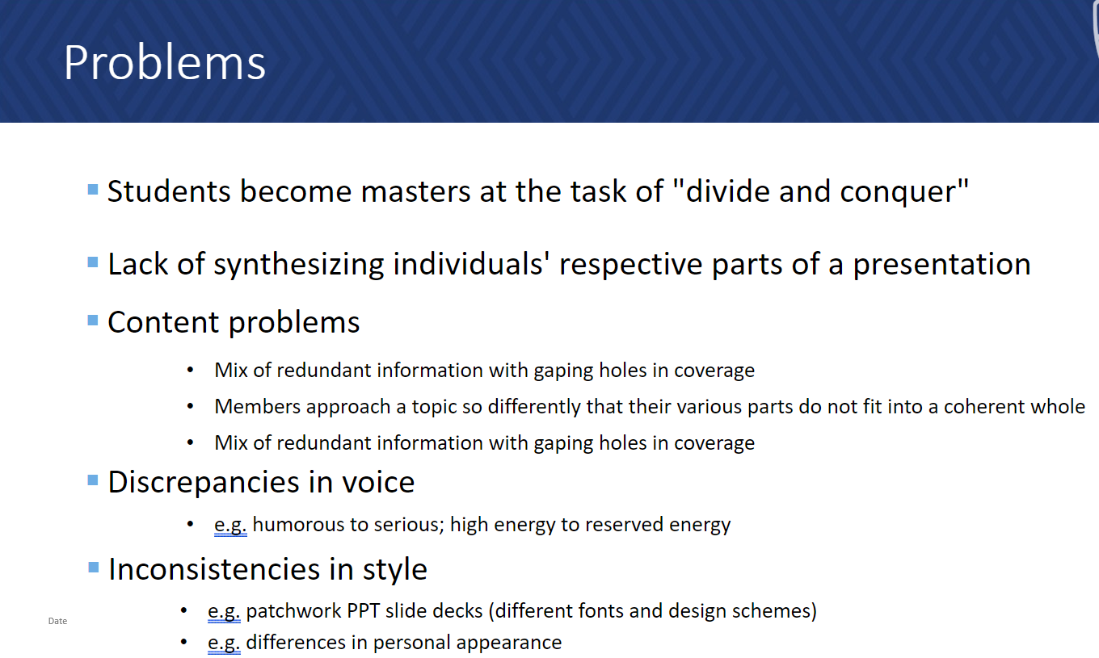
These kinds of inconsistencies can lead to a presentation that lacks a sense of
UNITY & COHESIVENESS

Slide 37
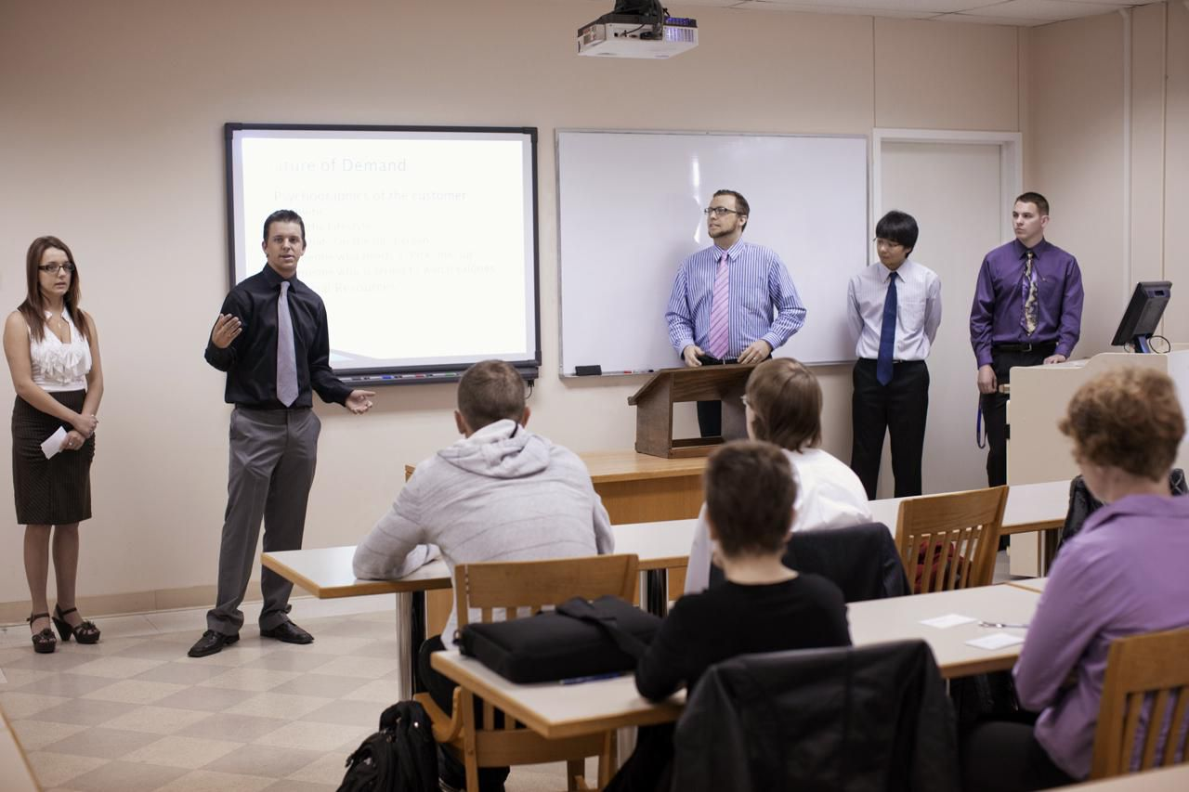
Problems with team dynamics in presentation​
Common Problems
Team-based delivery skills
Body positioning
Non-verbal communication of non-speaking members
Transitions between speakers
General inconsistencies
content
voice
style

Slide 38
Problems with team dynamics in presentation​
Solutions!
Team-based delivery skills
Physical position – be orderly
Nonverbal communication – communicate interest in the entire presentation
Use strong and confident body language
Look at speaker with interest
Pay attention to nonverbal signals you're giving (e.g. facial, crossed arms, fidgeting)
Introductions and transitions
Team members should practice smooth transitions between speakers

Slide 39
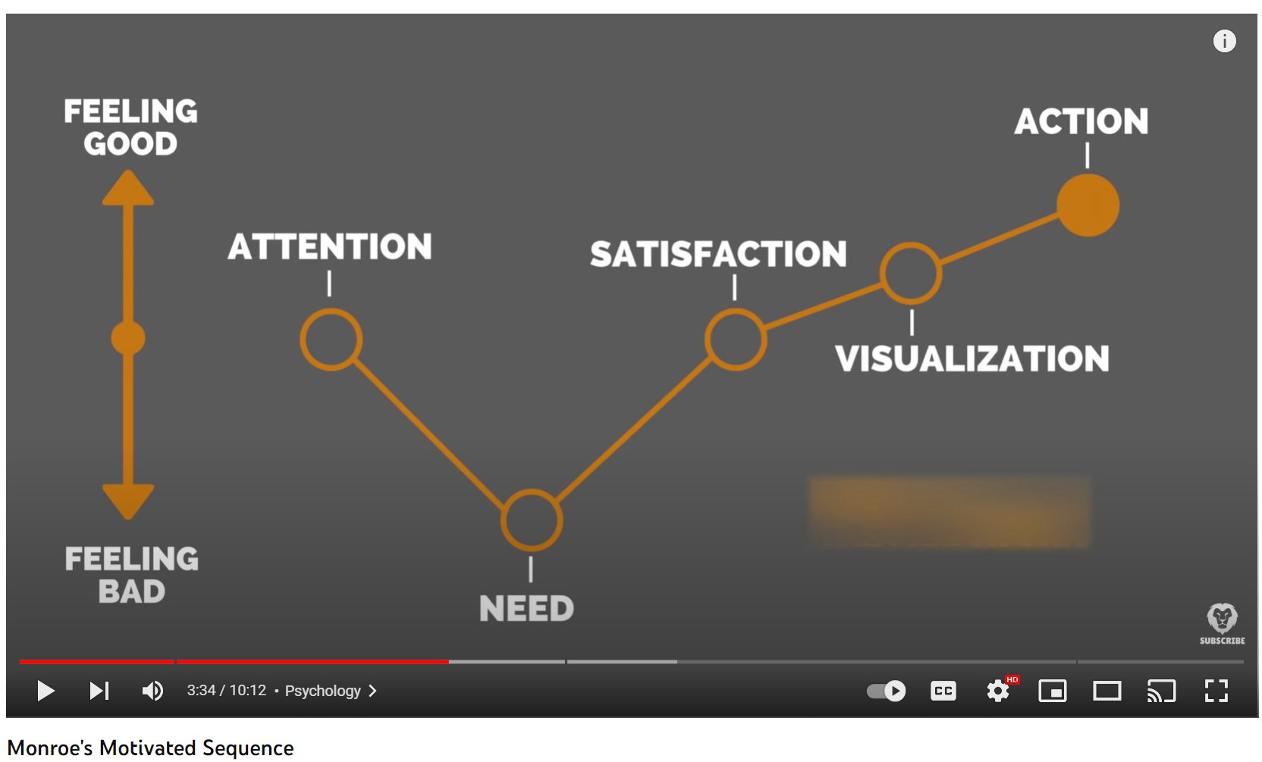
Monroe's motivated sequence (MMS)
Notes:
https://youtu.be/LMb65w9nLyo?si=Jxp-74esQI8nPO6g

Slide 40


Slide 41
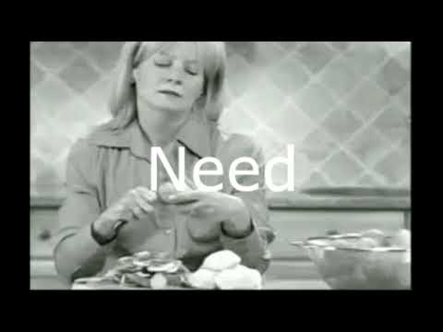
Notes:
https://youtu.be/xwSEPb6sdkw?si=WG7uKSrlcHiPEWKQ

Slide 42
Book review: come up with one multiple choices question on discussion board: Book: Duarte Group 1 – Section 2 Group 2 – Section 3 Group 3 – Section 4 Group 4 – Section 5 Group 5 – Section 2 Group 6 – Section 3 Group 7 – Section 4

Slide 43
MMS Team Presentation Activity
Goal: You have 15 minutes to invent a marketing campaign and develop a persuasive team presentation that follows the MMS format of Persuasive Speech/Pitch.
Each member will be responsible for developing one MMS step in the presentation, and the team will be evaluated on consistency in terms of content and demonstrated team delivery skills.

Slide 44
MMS Planning worksheet
See Mindtools, "Monroe's Motivated Sequence, https://www.mindtools.com/at48yzw/monroes-motivated-sequence
Teams should assign members to one of the MMS steps
Professor will distribute 2 sets of cards that will be the basis of the team presentation
30 seconds to present each MMS; total team presentation time = 2.5 mins
Aim to work together initially to generate direction the team is going in. Then due to time, you must "divide and conquer" in order to develop each step of MMS.
Final step: "Unify and present"
Notes:
https://www.mindtools.com/at48yzw/monroes-motivated-sequence

Slide 45
Focus of feedback （discussion）
The focus of feedback for the team should be directed at (1) how consistently team members worked toward the same end goal and (2) how well they presented as a team (not on the content of the presentation or individual delivery issues).

Slide 46
Debrief
How were you able (or what strategies did you use) to make sure that you had the same goal as your team?
What decisions or ground rules were you able to establish beforehand that helped you create a better unified presentation?
What ground rules do you wish you had established in retrospect?
What team delivery skills did you like the best?
Which ones were the easiest to implement?
Which ones might you need to practice more?
From everything you learned today, how is that going to change how you prepare for formal team presentations?

Slide 47
Critical Thinking Exercise
What are the differences and similarities between SUCCESs and MMS

